Slide 1


DevOps Butler Overview
Start here
Automating Local Deployments Effortlessly

Slide 2

Introduction
DevOps Butler simplifies the deployment process by automating the transition of projects from a Git repository to a live URL. It streamlines complex tasks like cloning, building, running, and networking, providing users with real-time logs and a user-friendly web interface.

Slide 3
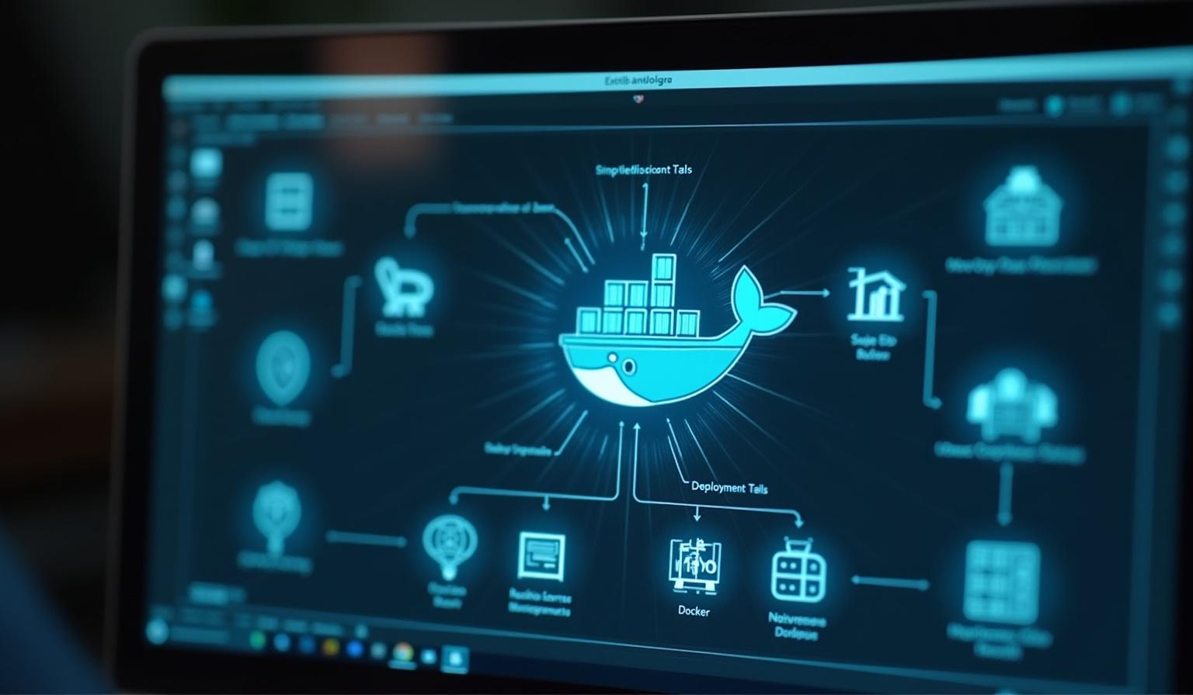
Introduction to DevOps Butler
01

Slide 4
Definition of DevOps Butler
DevOps Butler is a local deployment assistant that automates the process of deploying projects. It enhances efficiency by managing technical tasks typically required for deployment, making it user-friendly for developers at any level.

Slide 5

Purpose and Functionality
Its primary function is to automate the deployment process. DevOps Butler handles tasks like cloning repositories, building applications, and setting up networking, providing a seamless experience and reducing deployment errors.

Slide 6
Benefits of Using DevOps Butler
DevOps Butler significantly reduces deployment time and minimizes manual errors. By automating the generation of Dockerfiles and Nginx configurations, it simplifies the deployment process. This tool is ideal for local development, testing, and demos, allowing for quick clean-up and redeployment with just one click, making DevOps accessible to everyone.

Slide 7
Features and Workflow
02

Slide 8

Key Features Overview
DevOps Butler offers one-click deployments via a web interface. It intelligently analyzes project structures using Dockerfiles or AI-generated instructions, sets up automatic Nginx reverse proxies, and provides real-time logs of the deployment status, ensuring efficient management of deployment history.

Slide 9
How the Deployment Works
Users submit their Git repository URL, after which DevOps Butler clones the repository and analyzes its structure. It builds and runs applications using Docker or Docker Compose while configuring Nginx for user-friendly local URLs. Live logs are streamed to users for transparency during deployment.

Slide 10
Typical User Workflow
Users log into the web interface and input their GitHub repository URL. They can watch real-time logs as the application builds and deploys. Once deployed, users can access the application at a clean local URL, and they have the option to destroy or redeploy applications with a simple click.

Slide 11

Conclusions
DevOps Butler streamlines the process of local deployments, saving time and effort. Its automation of technical tasks enhances productivity and reduces the likelihood of errors, making it an essential tool for developers looking to enhance their workflow efficiency.

Slide 12
Thank you!
Do you have any questions?
+00 000 000 000

